Slide 1
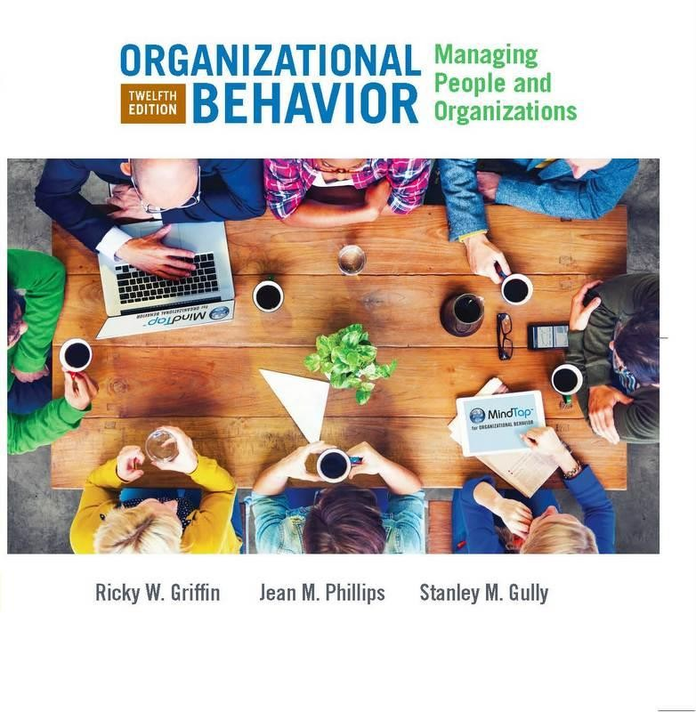
PART 1
Introduction to Organizational Behavior
CHAPTER 2
The Changing Environment of Organizations

Slide 2
Chapter Learning Objectives
After studying this chapter, you should be able to:
Describe the nature of diversity in organizations.
Describe the different types of diversity and barriers to inclusion that exist in the workplace.
Discuss the emergence of globalization and cross-cultural differences and similarities.
Discuss the changing nature of technology and its impact on business.
Describe emerging perspectives on ethics and corporate governance.
Discuss the key issues in new employment relationships.

Slide 3
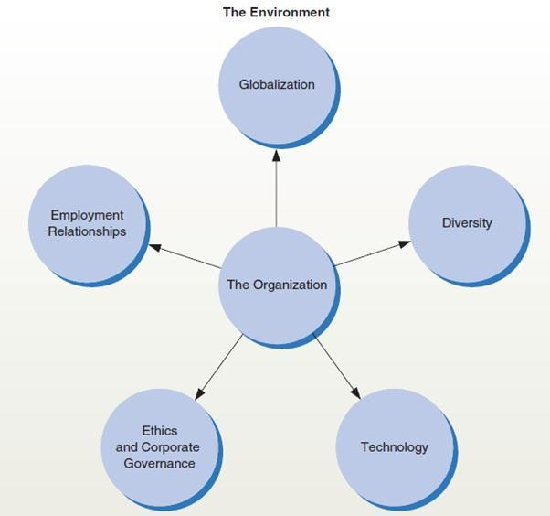
The Changing Environment of Business
Figure 2.1
The changing environment of business presents both opportunities and challenges for managers today.
Five important environmental forces are globalization, diversity, technology, ethics and corporate governance, and new employment relationships.

Slide 4
Diversity and Business (1 of 7)
Diversity
The variety of observable and unobservable similarities and differences among people
Types of diversity
Surface-level: Observable differences in people, including race, age,
ethnicity, physical abilities, physical characteristics, and gender
Deep-level: Individual differences that cannot be seen directly, including goals, values, personalities decision-making styles, knowledge, skills, abilities, and attitudes
Separation: Differences in position or opinion among group members reflecting disagreement or opposition—dissimilarity in an attitude or value, for example, especially with regard to group goals or processes

Slide 5
Diversity and Business (2 of 7)
Variety: Differences in a certain type or category, including group
members’ expertise, knowledge, or functional background
Disparity: Differences in the concentration of valuable social assets or resources—dissimilarity in rank, pay, decisionmaking authority, or status, for example
Trends in Diversity
The population is projected to become older.
By 2050, the total population is forecasted to grow from 282.1 million in 2000 to 419.9 million, a 49 percent increase.
Non-Hispanic Whites are expected to decrease.
Proportion of Blacks, Asians, and Hispanics will increase.
Talent shortages are forecast to rise globally.

Slide 6
Table 2.1 Five Types of Diversity
Surface-level diversity: observable differences in people, including gender, race, age, ethnicity, and physical abilities
Deep-level diversity: individual differences that cannot be seen directly, including goals,
values, personalities, decision-making styles, knowledge, and attitudes
Separation: differences in position or opinion among group members reflecting disagreement or opposition, especially with regard to group goals or processes— dissimilarity in an attitude or value, for example (a type of deep-level diversity)
Variety: differences in a certain type or category, including group members’ expertise,
knowledge, or functional background (a type of deep-level diversity)
Disparity: differences in the concentration of valuable social assets or resources— including dissimilarity in rank, pay, decision-making authority, or status (a type of deep-level diversity)

Slide 7
Diversity and Business (3 of 7)
Generational diversity
Age diversity
May result in younger managers supervising older workers
Reverse mentoring: pairing a junior employee with a senior employee to
transfer technical/computer skills from the junior employee to the senior one

Slide 8
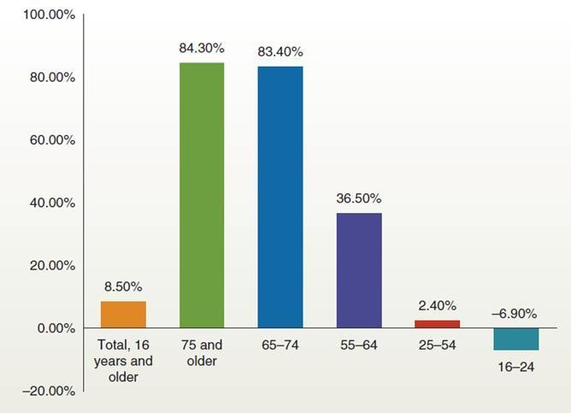
Projected Percentage Change in the U.S. Labor Force by Age from 2006 to 2016
Figure 2.2
The labor force in the United States is getting older. For example, as shown here, between 2006 and 2016 the number of U.S. workers between the ages of 65 and 74 grew by 83.4 percent, and the percentage of workers 75 and older grew by 84.3 percent. In contrast, the number of workers between the ages of 25 and 54 grew only by 2.4 percent.

Slide 9
Diversity and Business (4 of 7)
Generations (by birth year)
Seniors: 1922–1943
Baby boomers: 1943–1963
Generation X: 1964–1980
Generation Y/Millennials: 1980–2000
Generation Z: 2000-
Older workers may have better job performance but need mentoring to adopt new technology.
https://www.purdueglobal.edu/education-partnerships/generational-workforce-differences-infographic/

Slide 10
Diversity and Business (5 of 7)
Diversity issues for managers
The business case for diversity
Diversity also fosters greater creativity and innovation.
Organizational performance increases when employees have a positive
attitude toward diversity.
Culturally diverse teams make better decisions over time than homogeneous ones.
Women in top management results in more innovation.
Title VII of the Civil Rights Act of 1964 prohibits employment
discrimination based on race, color, religion, sex, or national origin.

Slide 11
Table 2.2 Barriers to Inclusion
The “like me” bias | People prefer to associate with others they perceive to be like themselves.
Stereotypes | A belief about an individual or a group based on the idea that everyone in a particular group will behave the same way or have the same characteristics.
Prejudice | Outright bigotry or intolerance for other groups.
Perceived threat of loss | If some employees perceive a direct threat to their own career opportunities, they may feel that they need to protect their own prospects by impeding diversity efforts.
Ethnocentrism | The belief that one’s own language, native country, and cultural rules and norms are superior to all others.
Unequal access to organizational networks | Women and minorities are often excluded from organizational networks, which can be important to job performance, mentoring opportunities, and being seen as a candidate for promotion

Slide 12
Diversity and Business (6 of 7)
Managing diversity
Top management support for diversity and for diversity initiatives.
Reciprocal mentoring: matches senior employees with diverse junior employees to allow both individuals to learn more about a different group.
Older adults may benefit fromself-paced learning environments and confidence-boosting interventions.
It is not realistic to claim or topursue an “I’m totally unbiased” stance with regard to diversity.

Slide 13
Globalization and Business (1 of 5)
Globalization
The internationalization of business activities and the shift toward an integrated global economy
Factors increasing globalization
Advances in communication and transportation
Businesses have expanded internationally to increase their markets.
Control of labor, distribution and distribution costs
Increased international competition

Slide 14
Globalization and Business (2 of 5)
Cultural competence
– Culture
o The set of shared values, often taken for granted,that help people in a group, organization, or society understand which actions are considered acceptable and which are deemed unacceptable
Cultural competence: The ability to interact effectively with people of different cultures
Awareness of our worldview and our reactions to people who are different
Our attitude toward cultural differences
Knowledge of different worldviews and cultural practices
Cross-cultural skills

Slide 15
Globalization and Business (3 of 5)
Cross-Cultural Differences and Similarities
General observations
Cultural and national boundaries may not coincide
Behavior in organizational settings varies across cultures
Culture is one major cause of this variation
Organizations and the way they are structured appear to be growing increasingly similar.
The same individual behaves differently in different cultural settings.
Cultural diversity can be an important source of synergy in enhancing
organizational effectiveness.

Slide 16
Globalization and Business (4 of 5)
Specific Cultural Issues
Geert Hofstede’s research
Attitudes and behaviors differ significantly because of values and beliefs that
characterize those countries
Hofstede’s Categories
Individualism
Collectivism
Power distance
Uncertainty avoidance
Masculinity
Long-term orientation
Short-term orientation

Slide 17
Hofstede’s Primary Dimensions
Individualism | Exists to the extent that people in a culture define themselves primarily as individuals rather than as part of one or more groups or organizations
Collectivism | Characterized by tight social frameworks in which people tend to base their identities on the group or organization to which they belong
Power distance | The extent to which people accept as normal an unequal distribution of power
Uncertainty avoidance (also preference for stability) | The extent to which people feel threatened by unknown situations and prefer to be in clear and unambiguous situations
Masculinity (also assertiveness or materialism) | The extent to which the dominant values in a society emphasize aggressiveness and the acquisition of money and other possessions as opposed to concern for people, relationships among people, and overall quality of life
Long-term Values | Include focusing on the future, working on projects that have a distant payoff, persistence, and thrift
Short-term Values | More oriented toward the past and the present and include respect for traditions and social obligations

Slide 18
Table 2.3 Work-Related Differences in 10 Countries
Country | Individualism /Collectivism | Power Distance | Uncertainty Avoidance | Masculinity | Long-Term Orientation
CANADA | H | M | M | M | L
GERMANY | M | M | M | M | M
ISRAEL | M | L | M | M | (no data)
ITALY | H | M | M | H | (no data)
JAPAN | M | M | H | H | H
MEXICO | H | H | H | M | (no data)
PAKISTAN | L | M | M | M | L
SWEDEN | H | M | L | L | M
UNITED STATES | H | M | M | M | L
VENEZUELA | L | H | M | H | (no data)
Note: H = high; M = moderate; L = low for INDIVIDUALISM/COLLECTIVISM. H means High Individualism, L means High Collectivism and M means a balance of individualism and collectivism. These are only 10 of the more than 60 countries that Hofstede and others have studied.
References: Adapted from Geert Hofstede and Michael Harris Bond, “The Confucius Connection: From Cultural Roots to Economic Growth,” Organizational Dynamics, Spring 1988, pp. 5–21; Geert Hofstede, “Motivation, Leadership, and Organization: Do American Theories Apply Abroad?” Organizational Dynamics, Summer 1980, pp. 42–63.

Slide 19
Globalization and Business (5 of 5)
Global Perspective
A willingness to be open to and learn from the alternative systems and meanings of other people and cultures, and a capacity to avoid assuming that people from everywhere are the same.

Slide 20
Technology and Business (1 of 2)
Technology
Refers to the methods used to create products, including both physical goods and intangible services
Manufacturing
A form of business that combines and transforms resources into tangible
outcomes that are then sold to others
Service organization
One that transforms resources into an intangible output and creates time or place utility for its customers

Slide 21
Technology and Business (2 of 2)
Technology and Competition
Maintaining a leadership position: technology is the basis of competition for some firms
Coping with decreasing cycle times (the time it takes a firm to accomplish some recurring activity or function, e.g., making deliveries, processing credit payments)
Information technology and social media
Advantages: leaner and more flexible organizations, increased collaboration, improved management processes/systems
Disadvantages: less personal communication, less “down time,” an increased sense of communication and decision-making urgency

Slide 22
Ethics and Corporate Governance (1 of 3)
Ethics
A person’s beliefs regarding what is right or wrong in a given situation
Framing ethical issues
Treatment of employees (hiring, firing, wages, working conditions, respect, privacy)
How employees treat the organization (conflicts of interest, secrecy, confidentiality, personal internet use, unacceptable absenteeism)
Treatment of economic agents (customers, competitors, stockholders, suppliers, dealers, unions)
Variations in ethical and legal business practices across countries

Slide 23
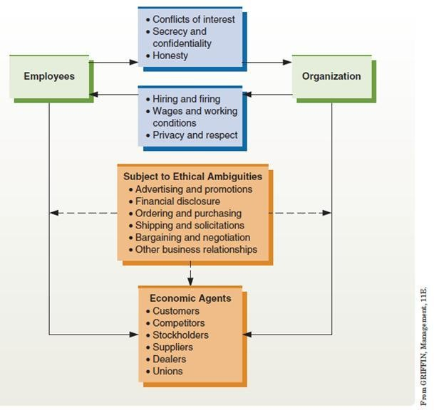
Managerial Ethics
Figure 2.3
Managers face a variety of ethical situations. In most cases these situations involve how the organization treats its employees, how employees treat the organization, and how employees and organizations treat other economic agents.

Slide 24
Ethics and Corporate Governance (2 of 3)
Corporate governance
Refers to the oversight of a public corporation by its board of directors
Governance issues
Proper management of the business in the best interests of shareholders and other stakeholders
Independence of the board from the business
Ethical Issues and Information Technology
individual rights to privacy and the potential abuse of information technology by companies.

Slide 25
Ethics and Corporate Governance (3 of 3)
Social responsibility
Businesses living and working together for the common good and valuing human dignity
have lasting effects, social responsibility efforts should be integrated into the culture of the organization
The International Organization for Standardization (ISO) has created a variety of standards that help organizations gain international acceptance of their practices and outcomes.

Slide 26
New Employment Relationships (1 of 5)
Management of knowledge workers
Those employees who add value in an organization simply because of what they know
Examples: computer scientists, physical scientists, engineers, product
designers, video game developers
Knowledge worker employment issues
Unique working arrangements and performance motivation requirements
Autonomous work, strong identification with professional standard,
continual updating of skills
Specifically (individually) tailored compensation packages
Growth opportunities, profit sharing, less bureaucracy

Slide 27
New Employment Relationships (2 of 5)
Outsourcing
The practice of hiring other firms to do work previously performed by the organization itself; when this work is moved overseas, it is often called offshoring
Advantages of outsourcing
Helps firms to focus on core activities
Lowers labor costs through exportation of work
Disadvantages of outsourcing
Disaffected employees: out-of-job workers are used to train the newly hired foreign replacements
Reduction of domestic job opportunities

Slide 28
New Employment Relationships (3 of 5)
Offshoring
Outsourcing to workers in another country
Advantages of offshoring
Lower labor costs
Disadvantages of offshoring
Results in loss of jobs in home country
Controversial issue

Slide 29
New Employment Relationships (4 of 5)
Temp and contingency workers
Work for an organization on something other than a permanent or full- time basis as independent contractors, on-call workers, temporary employees (usually hired through outside agencies), and contract and leased employees
contingent worker: A person who works for an organization on something other than a permanent or full-time basis
Tiered workforce
When one group of an organization’s workforce has a contractual arrangement with the organization objectively different from another group performing the same jobs
Occurs with contracts negotiated at different times

Slide 30
New Employment Relationships (5 of 5)
Psychological contract
A person’s set of expectations regarding what he or she will contribute to an organization and what the organization, in return, will provide to the individual
Individuals contribute effort, skills, ability, time, loyalty
Organizations provide inducements in the form of tangible/intangible rewards

Slide 31
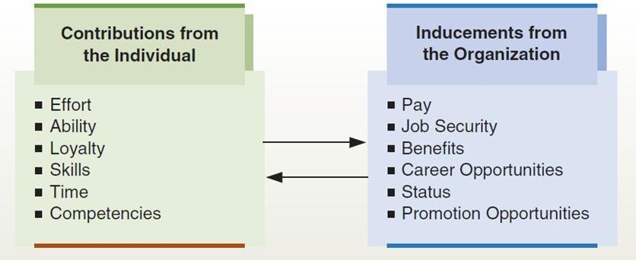
The Psychological Contract
Figure 2.4
Psychological contracts govern the basic relationship between people and organizations. Individuals contribute such things as effort and loyalty. In turn, organizations offer such inducements as pay and job security.

Slide 32
Organizational Behavior in Action (1 of 2)
After reading the chapter:
Which do you think is more important to team performance, surface- level or deep-level diversity? Why?
How can diversity create a competitive advantage for a firm?
If a subordinate came to you and said that they felt the company’s new diversity hiring initiative was unfair and would compromise their welldeserved opportunities for advancement, how would you respond?
What can leaders do to be effective when team members are from different cultures and have different expectations about how the leader should behave?
Identify at least three ways in which the globalization of business affects businesses in your community.

Slide 33
Organizational Behavior in Action (2 of 2)
What roles do changing technologies play in your daily activities?
Do you think that concerns regarding ethics will become more or less important in business? Why?
What are your personal opinions about international outsourcing in the garment industry? Do you think that lower prices are worth sending U.S. jobs to other countries? Explain your answer.

